Slide 1

Marriage and Dating Pt. 2
Finding the Right Woman

Slide 2

Where I’m Coming From

Slide 3

Why Date or Get Married in the First Place?
As a believer, if you embark on the activity of dating, your end goal is to get married. PERIOD. You cannot date just to have fun or to play around.

Slide 4

What About Singleness?
There is nothing wrong with singleness. The Apostle Paul talked such about his singleness in his letters. Other notable individuals who were single were Jeremiah, Elijah, Elisha, Daniel, Nehemiah, John the Baptist, Barnabas, Timothy, Titus, and Silas.
All married people started out single. If the Lord takes you through a season or a lifetime of singleness, trust His plans. But remember that if you are dating, you are spending time getting to know a woman to see if you are compatible for the end goal of being married.

Slide 5
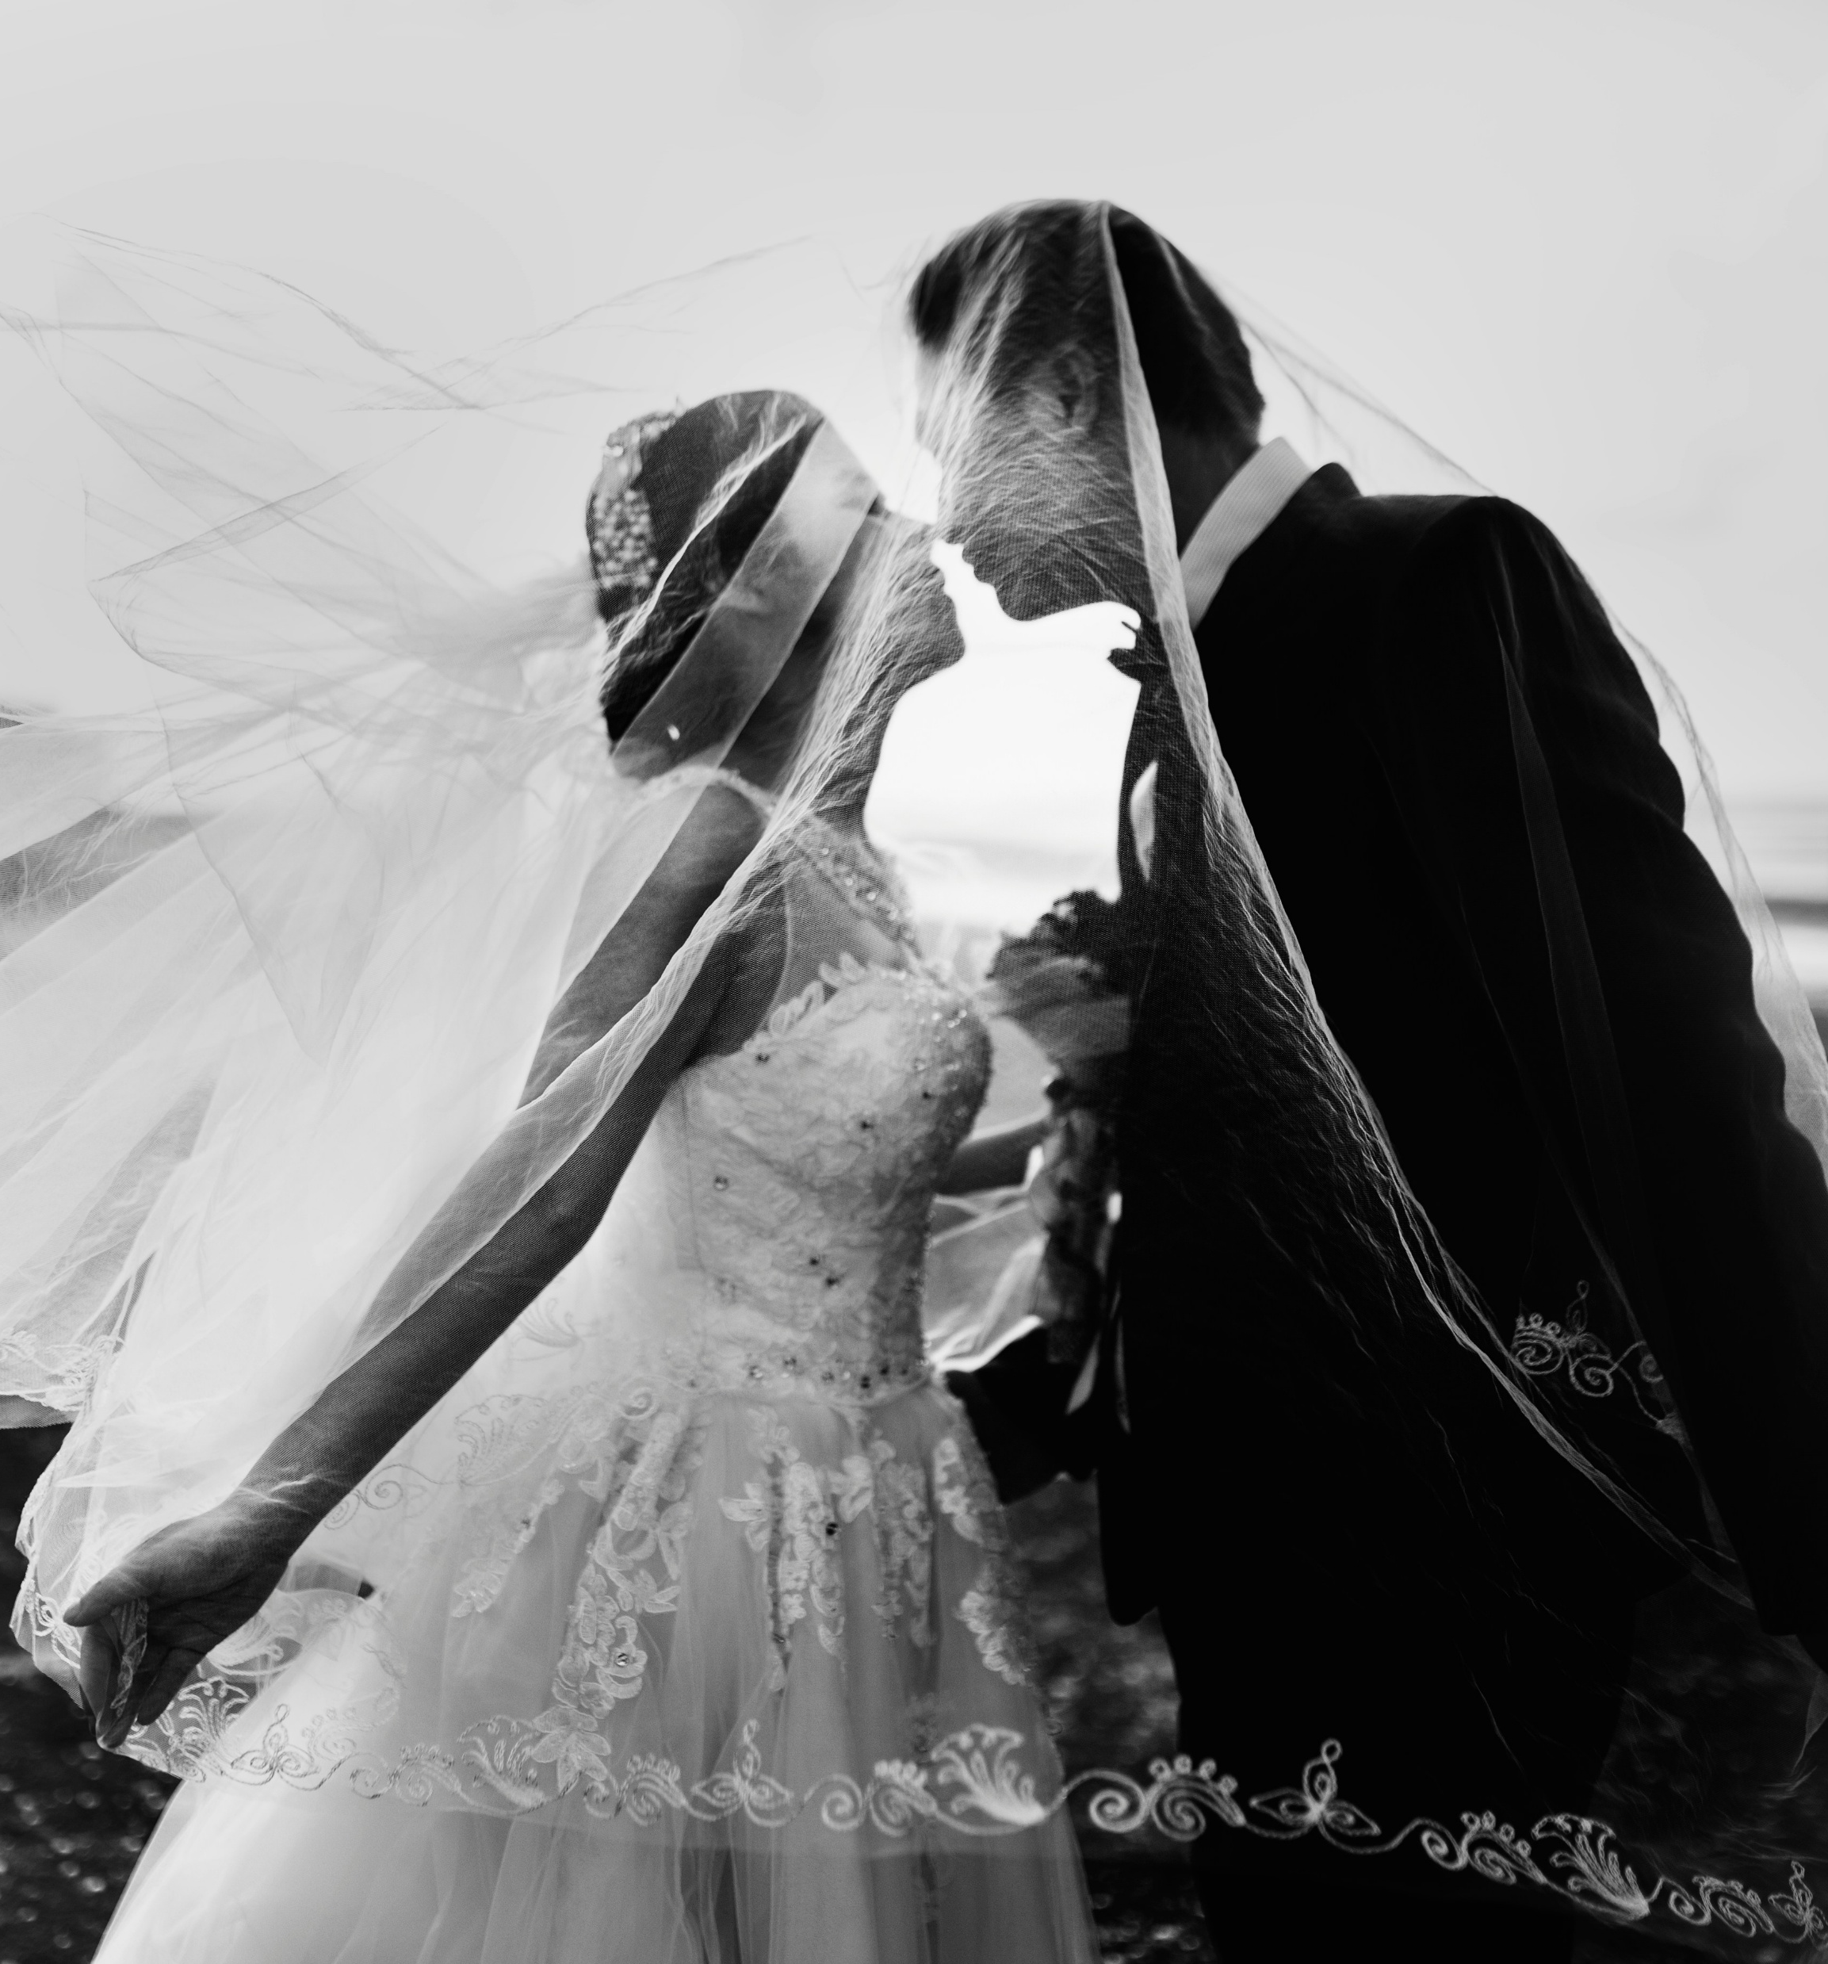
A Wedding is Not a Marriage
Today’s society puts pressure on couples to have the most spectacular, most lavish, most amazing wedding in the world.
The sad point is couples tend to spend tens of thousands of dollars and several months of time on a wedding (especially the bride-to-be), yet won’t spend a single dollar or a single minute on preparing how to have a great marriage.

Slide 6

Definition of Marriage: To Make a Couple Holy. To Give Glory to God.
A couple doesn’t get married to gain happiness.
A couple doesn’t get married to share two incomes to make getting through life easier financially.
A couple doesn’t get married to be able to enjoy sexual intercourse.
A couple doesn’t get married to escape loneliness.
There are many other reasons people use, thinking it is an answer to fix or solve problems, or to alleviate pressures.
But it is to make each other holier for God.

Slide 7

Part 1 – Becoming the Right Christian Man For Your Girlfriend or Wife
Please refer to the previous slideshow/notes, found at
scottroberts.org/marriage-and-dating

Slide 8

The “Great Eight”: Essential Traits to Look for in a Woman

Slide 9
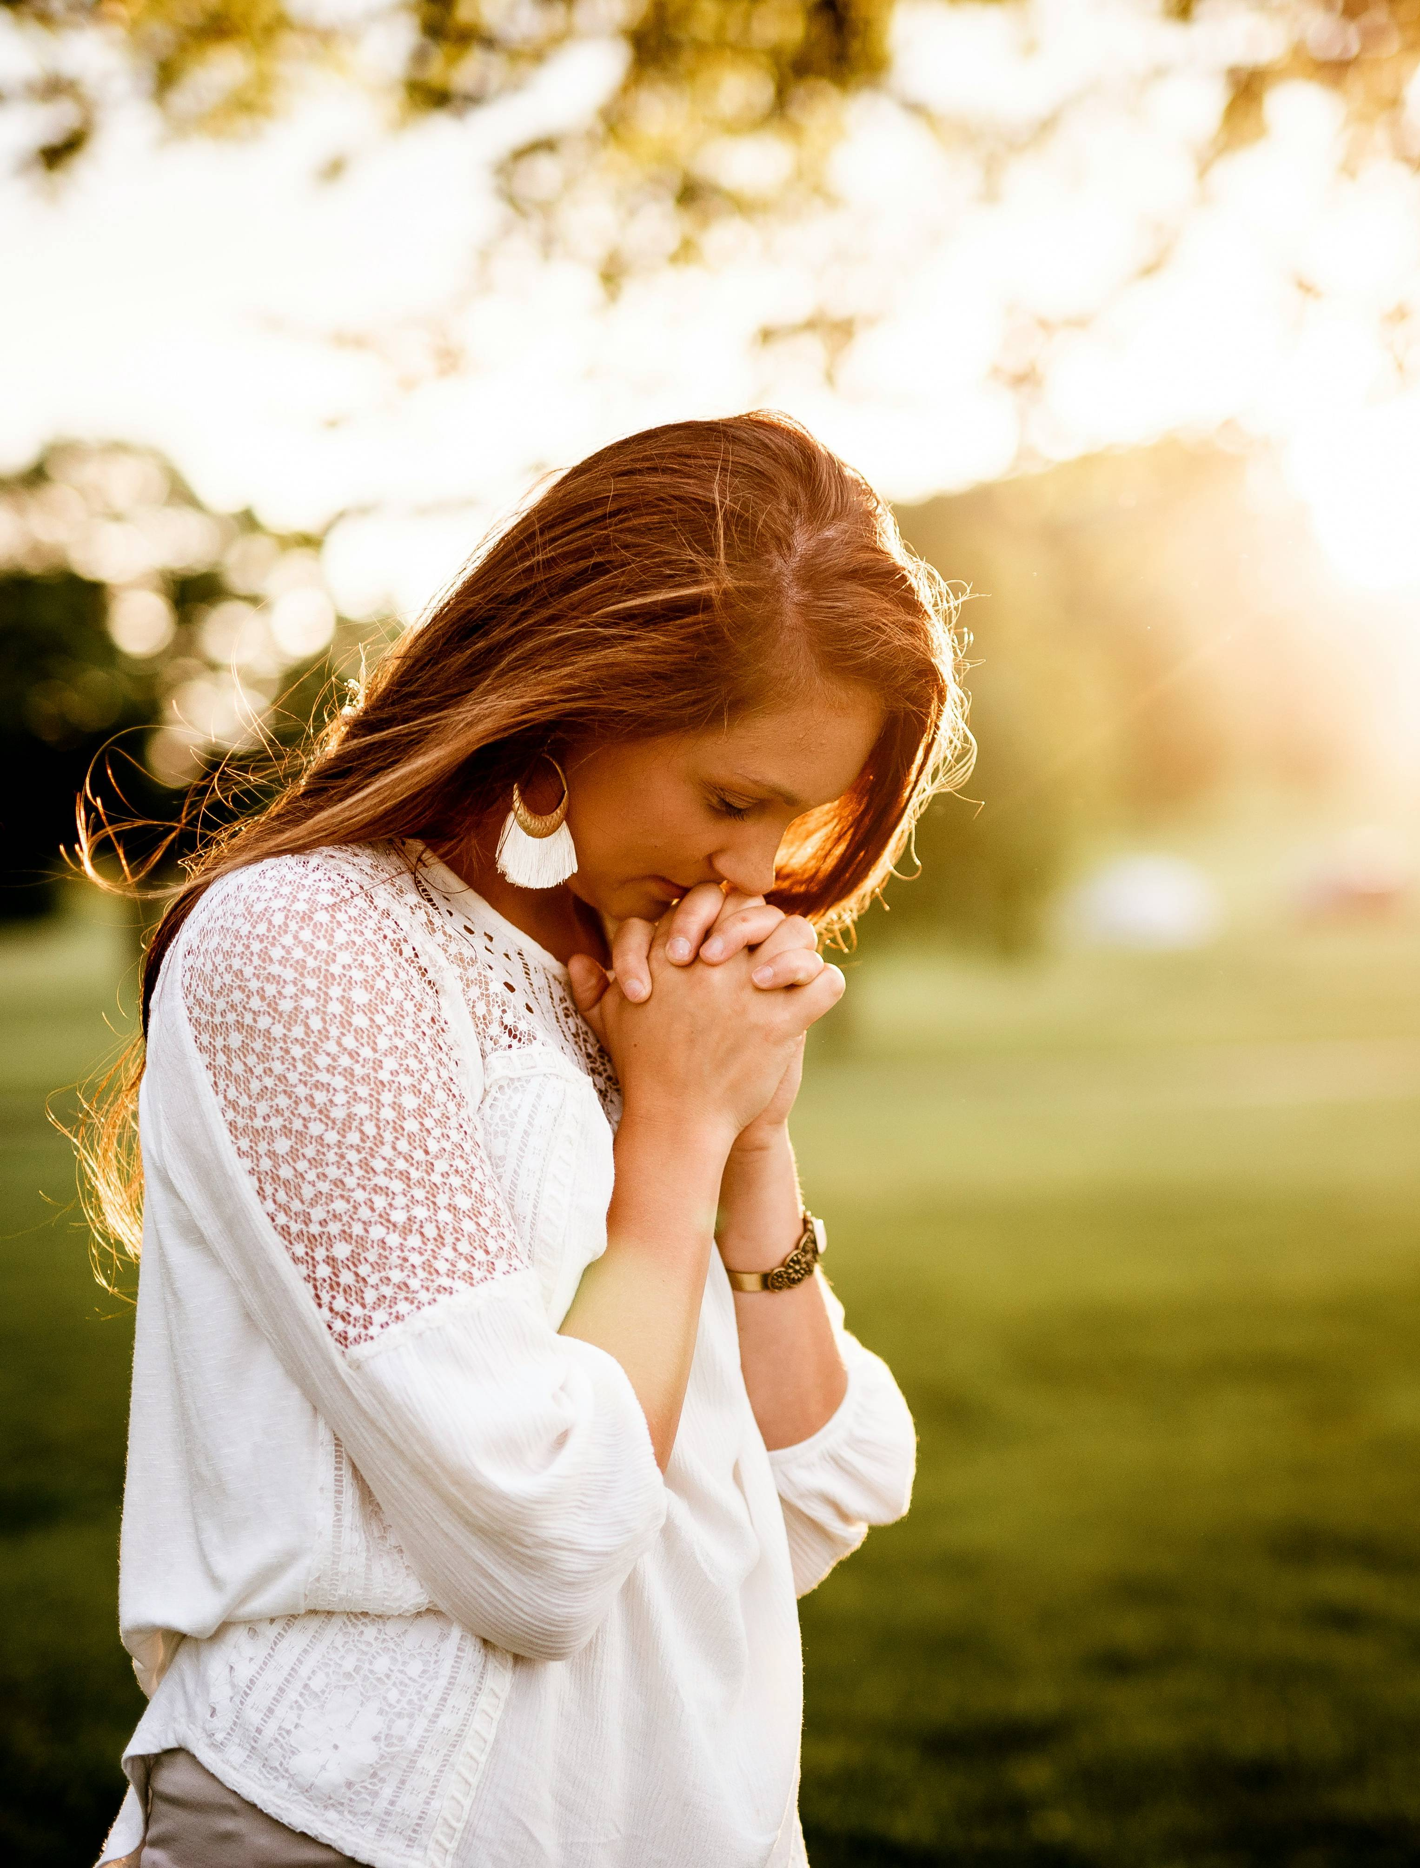
1. She Must Have a Genuine Faith in Christ
Finding the Right Woman

Slide 10

2. She Exhibits Commitment to God's Word and Prayer
Finding the Right Woman

Slide 11

3. She Has Emotional and Spiritual Maturity
Finding the Right Woman

Slide 12

4. She Has A Heart for Service
Finding the Right Woman

Slide 13

5. You Two Have Alignment in Values and Mission
Finding the Right Woman

Slide 14


6. She Has a Teachable and Humble Spirit
Finding the Right Woman

Slide 15

7. She Has A Spirit of Encouragement
Finding the Right Woman

Slide 16

8. Purity, Biblical Sexuality and Integrity
Finding the Right Woman

Slide 17

Red Flags: Telltale Warning Signs
A “red flag” is a potentially unhealthy, dangerous, or toxic behavior, value, or pattern of a person you're involved with. It's a signal that shouldn't be ignored.
Finding the Right Woman

Slide 18

Red Flags Rapid-Fire Roundup
Shallow or Inconsistent Faith
Disrespect or Lack of Submission to Authority
Negative or Bitter Attitude
Manipulation or Control
Worldliness
Disregard for Biblical Purity
Poor Financial Stewardship
Drama or Gossip
Unavailability (“It’s Complicated”)
She Hides Texts/Messages/Social Media
Rude, Insensitive, and Overly Judgmental
Dishonesty
Unresolved Trauma or Addiction
Negative Views on Men & Marriage
Finding the Right Woman

Slide 19

Yellow Flags
A yellow flag in a relationship is a warning sign or concern that isn't a full-blown dealbreaker yet, but something that needs to be addressed before it potentially grows into a serious problem. Sometimes the man and woman can have a healthy relationship with yellow flags, but only if each other practices grace, understanding, and compromise.
Finding the Right Woman

Slide 20
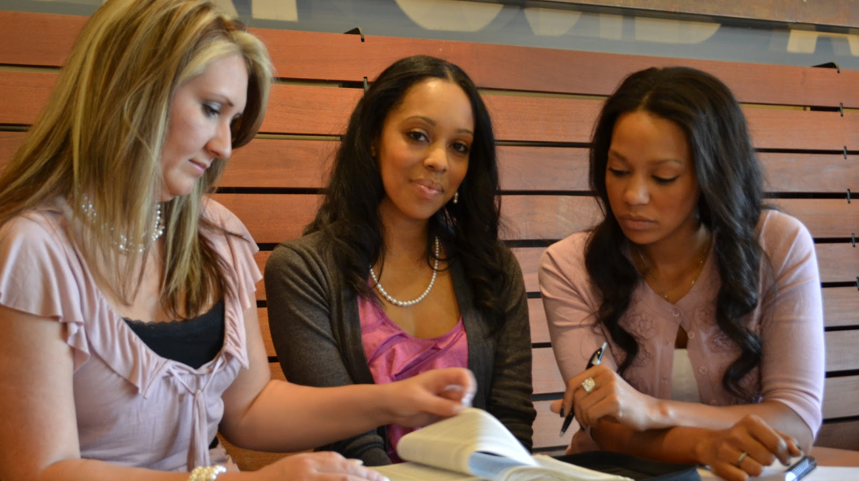
Of course, the question that everyone asks… Where Do You Find Single Christian Women?
Finding the Right Woman

Slide 21
Where Do You Find Single Christian Women?
1. Local Church Services and Ministries
2. Young Adults Group, Discipleship Groups or Bible Studies 3. Christian Conferences and Retreats 4. Christian Dating Sites or Apps (e.g., Christian Mingle, Upward, eharmony) 5. Volunteering for Christian Charities, Food Banks or Missions 6. Christian Colleges or Seminaries (Community Events or Courses) 7. Worship Nights or Christian Concerts 8. Mutual Friends and Church Networks
(Continued)
Finding the Right Woman

Slide 22
Where Do You Find Single Christian Women?
9. Social Media (Used Wisely)
10. Christian Bookstores or Coffee Shops (Near Seminaries or Churches)
11. Community Events Hosted by Churches (Game Nights, Potlucks, Theology Nights)
12. Christian Camps or Family Conferences
13. Co-ed Christian Classes in other churches
14. Mission Trips
Finding the Right Woman

Slide 23

Any questions?

Slide 24
One Last Word

Slide 25

Thank You! You can download both Part 1 and Part 2 at: scottroberts.org/marriage-and-dating

